Slide 1
Version Control with Git and GitHub
By Innocent Suta

Slide 2
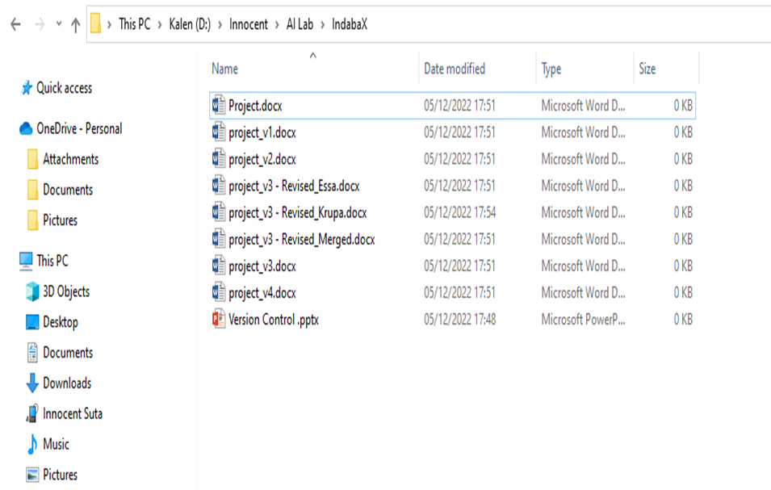
What is version control?
Version control allows you to keep track of your work and helps you to easily explore the changes you have made, be it data, codes, notes etc.
Challenges of working on a project
Undo and Redo
Tracking changes
Working with others
Sharing Changes
Overlapping work when working in a team

Slide 3
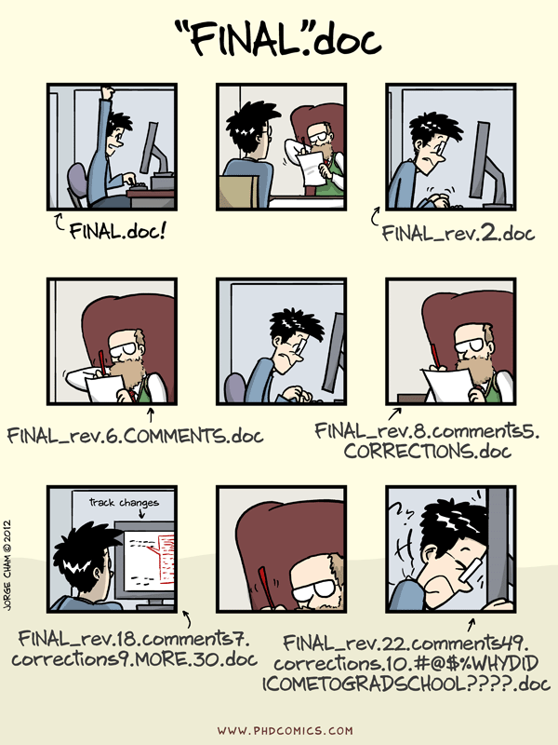

Slide 4
Why use version control?
History of changes – Each file in the local or remote repository has a history making it easy to explore the changes that occurred to it at different time points
No worries about breaking things that work - revert to the previous version
Merging changes from multiple people
Review other people’s code, add comments to certain lines or the overall document and suggest changes.
Version control allows you to keep track of your work and easily navigate among the many versions of the files you create, whilst also maintaining an online backup (Github, Bitbucket etc)

Slide 5
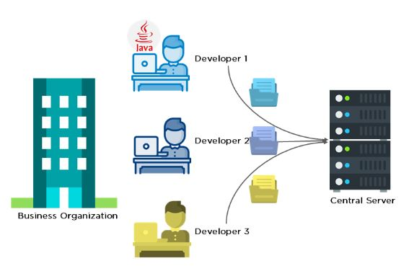
Before Git
Developers used to submit their codes to the central server without having copies of their own
Any changes made to the source code were unknown to the other developers
There was no communication between any of the developer

Slide 6
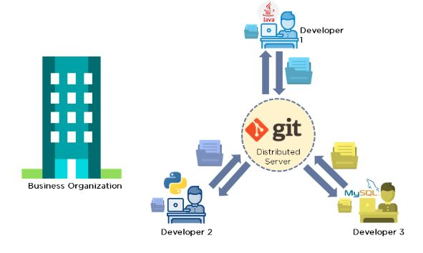
After Git
Every developer has an entire copy of the code on their local systems
Any changes made to the source code can be tracked by others
There is regular communication between the developers

Slide 7
What is git?
Git is a version control system used for tracking changes in computer files. It is widely used for source code management in software development.
Developed by Linus Torvalds (developer of Linux) in 2005.
used to manage the source code for Linux
Track any content.
Source code
data analysis projects
Manuscripts
Websites
Git makes version control much smoother and easier to implement.

Slide 8
Why use git?
It’s fast - Applying updates should not take longer than 3 seconds
You don’t need access to a server
Support distributed system workflow
Take the Concurrent Version System - (free and Paid software)
It allows multiple developers to work together
It supports non-linear development through its thousands of parallel branches

Slide 9
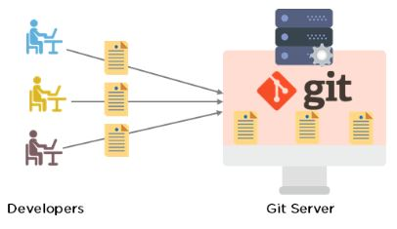
Git main features
Tracks history and changes
Supports non-linear development
Creates backups
Scalable
Supports collaboration
Branching is easier
Distributed development

Slide 10
What’s GitHub
GitHub is a Git repository hosting service that provides a web-based graphical interface.
It is the world’s largest coding community. Hosting your code or project on GitHub brings it increased, widespread exposure. Programmers can find source codes in many different languages and use the command-line interface, Git, to make and keep track of any changes.
GitHub helps every team member work together on a project from any location while facilitating collaboration. You can also review previous versions created at an earlier point in time.
GitHub’s Competitors: Bitbucket, Google Cloud Source Repositories, Phabricator, GitLab, Gogs, Gitea, SourceForge, Apache Allura, Launchpad and AWS CodeCommit

Slide 11
Why use github ?
Having a GitHub repo makes it easy for you to keep track of collaborative and personal projects
GitHub allows you to assign tasks to different users, making it clear who is responsible for which part of the analysis, feature of the project or code
Graphical user interface for git
Exploring code and its history
Tracking issues
Facilitates:
Learning from others
Seeing what people are up to
Contributing to others’ code or open-source projects.

Slide 12
GitHub’s features
Easy Project Management
Increased Safety With Packages
Effective Team Management
Improved Code Writing
Increased Code Safety.
Easy Code Hosting

Slide 13
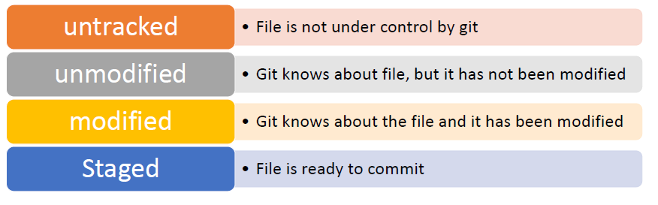
Git : STATUS

Slide 14
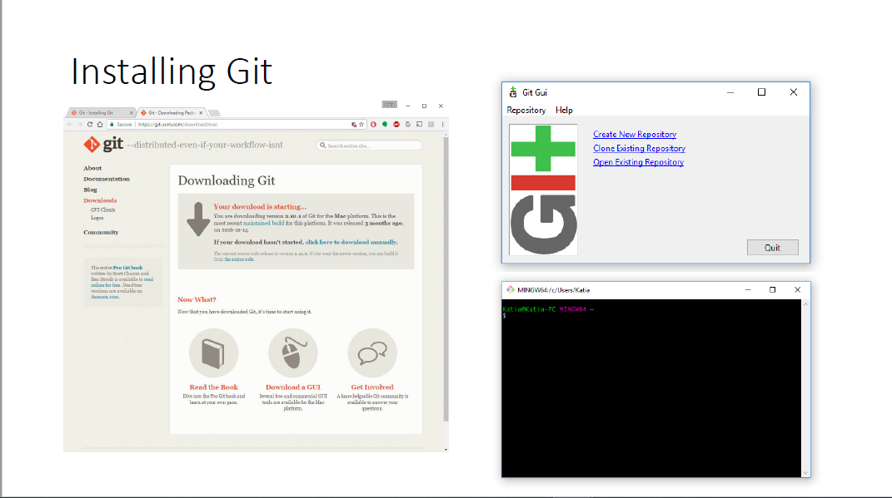
Git installation

Slide 15
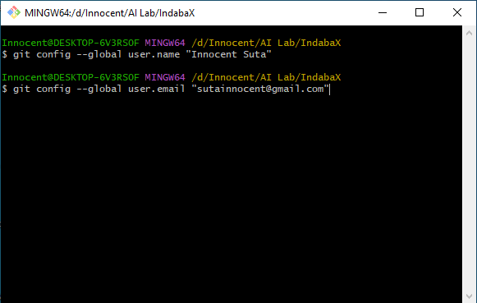
Git : basic configuration

Slide 16
Github : set up repository
Get a GitHub account
Click the “Create a new repo”
Give it a name and description
Click the “Create repository” button

Slide 17
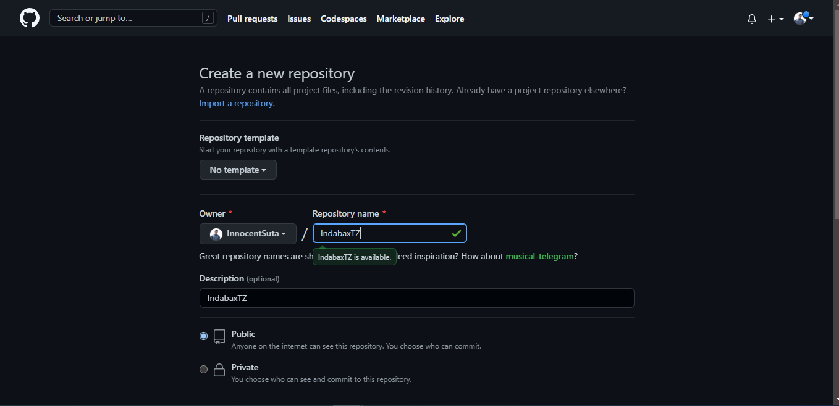
GitHub : set up repository

Slide 18
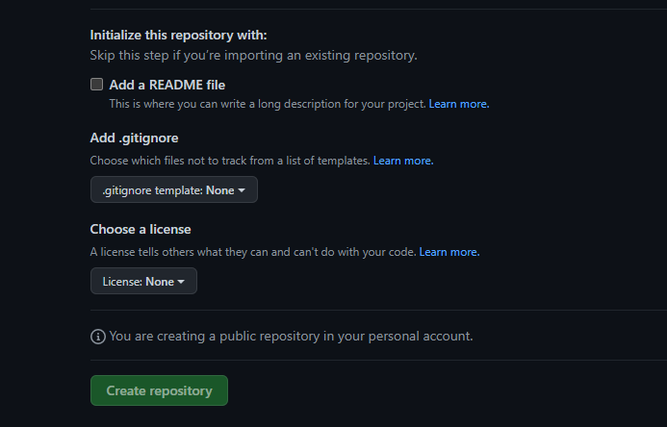
GitHub : set up repository

Slide 19
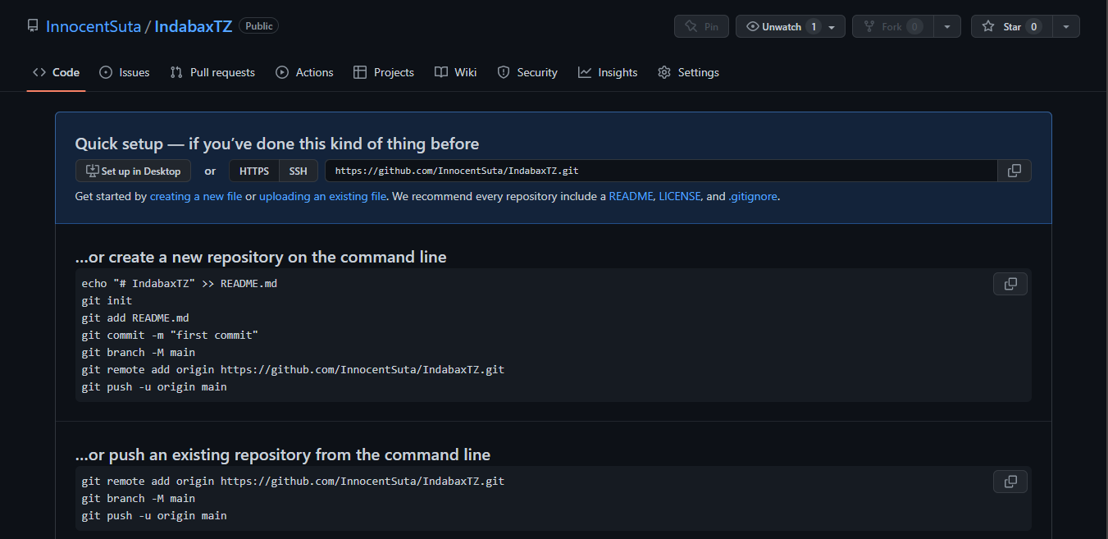
Github : Set up repository

Slide 20
Pushing your project on github

Slide 21
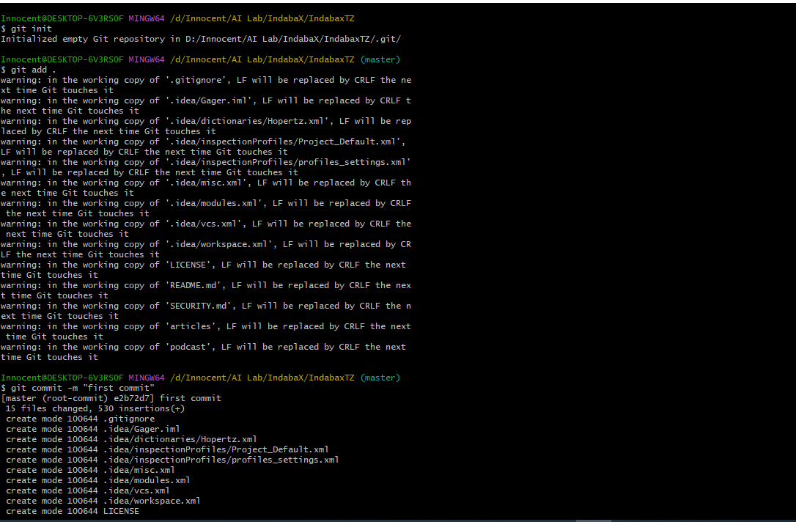
Initialize repository
Create (and cd to) a working directory
E.g, ~/IndabaX/IndabaxTZ
Initialize it to be a git repository
git init
Incorporate into repository
Stage the changes using git add
Now commit using git commit
The -m argument allows one to enter a message
Use a meaningful message
Message can have multiple lines, but make 1st line an overview

Slide 22
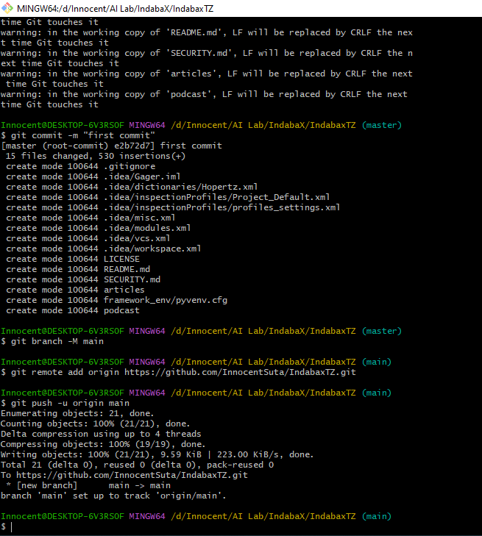
Use git status to check if you’re missing anything.
Push to the branch that you’re working on.
Set up .gitignore file

Slide 23
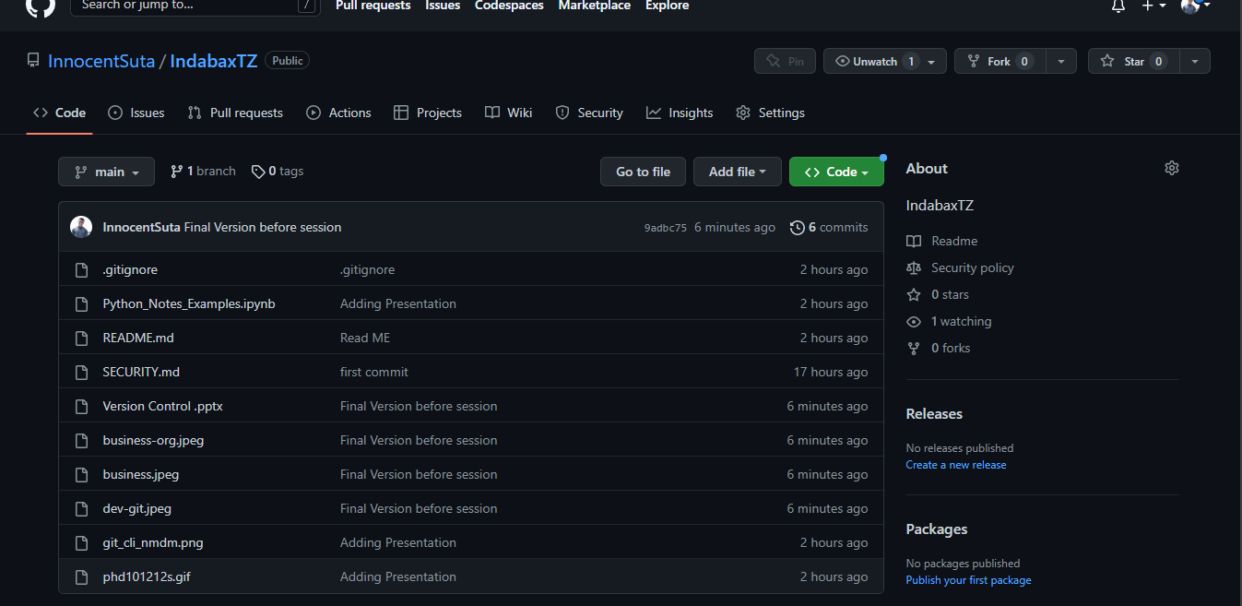

Slide 24
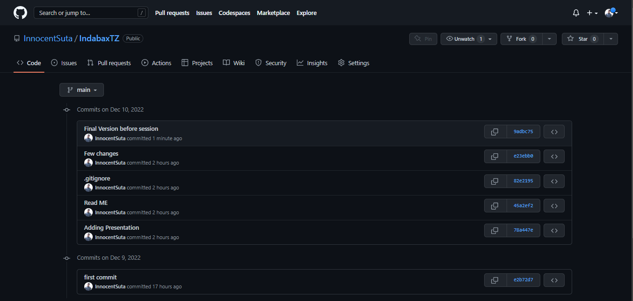

Slide 25
Removing/moving files
Use the following for all files that are tracked by git.
Use git rm instead of just rm
Use git mv instead of just mv

Slide 26
Destroy it and start over
Why?
You commit something you shouldn’t have (large and/or private)
You are embarrassed by your repository’s history
You can’t figure out the mess you’ve made
Pick the repository you like and destroy the other one
For example, get your local directory in the state you like and destroy everything else
Local repository
If you delete the .git subdirectory, it’ll no longer be a git repository
GitHub repository
Go to the settings for the repository and head down to the Danger Zone

Slide 27
Branching and Merging
Use branches to test out new features without breaking the working code.
git branch develop
git branch
git checkout develop
When you’re happy with the work, merge it back into your master branch.
git checkout master
git merge develop

Slide 28
Issues and Pull requests
Problem with or suggestion for someone’s code?
Point it out as an Issue
Provide a fix or better solution or suggesting a change to an existing repo
Fork the repository
Clone your version of it – git clone https://github.com/InnocentSuta/IndabaxTZ
Modify / change things locally - git add
Commit changes – git commit
Push to your repository - git push
Submit a Pull Request - “Pull Requests” and “New pull request”

Slide 29
Summary

Slide 30
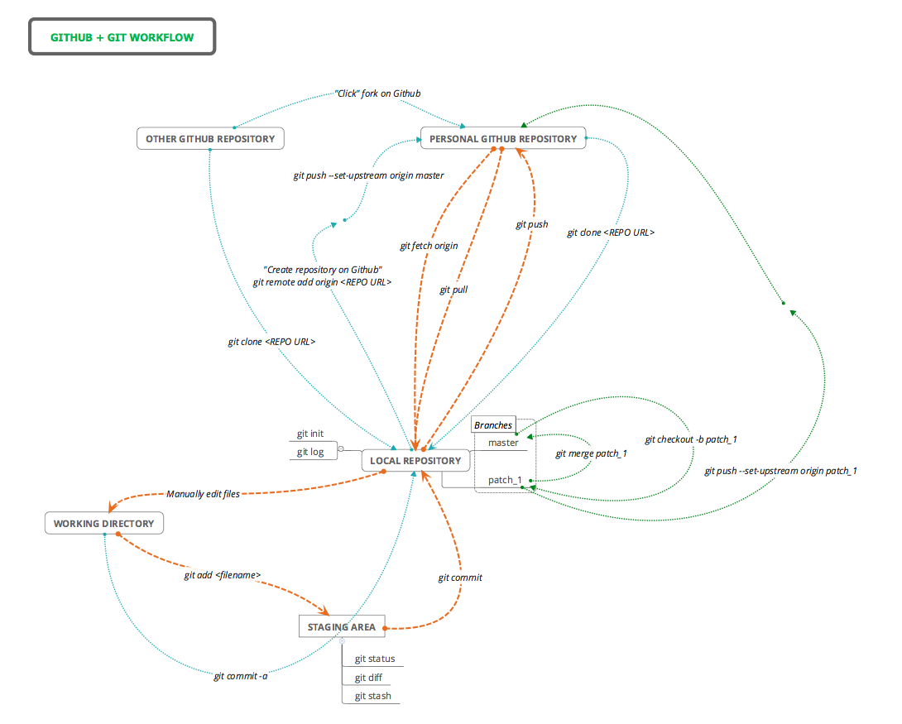

Slide 31
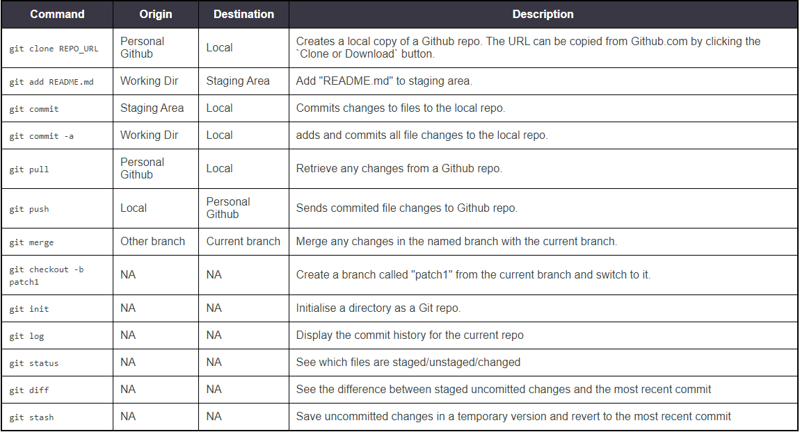

Slide 32
Thank you ☺

